Slide 1
Configuring and Deploying an Engaging Service Portal
LAB0261: Platform Essentials
Sushruth Chandrashekar Senior UI Developer, Platform Innovation
Dylan Lindgren Senior UI Developer, Platform Innovation

Slide 2
Agenda
Introductions
Portals & Pages
Widgets
External Dependencies & Best Practices
Bonus Lab!

Slide 3
Speaker Introduction
Name: Sushruth Chandrashekar
Title: Senior UI Developer
Function: Platform Innovation Practice
Company: ServiceNow (San Diego, USA)
Replace with your picture
Notes:
Note: Speaker Introduction slide – option 1. Please use one slide per presenter.

Slide 4
Speaker Introduction
Name: Dylan Lindgren
Title: Senior UI Developer
Function: Platform Innovation Practice
Company: ServiceNow (Sydney, Australia)
Notes:
Note: Speaker Introduction slide – option 1. Please use one slide per presenter.

Slide 5
What You Will Learn
1
2
3
UNDERSTAND INDUSTRY CHALLENGES
LEARN ABOUT [YOUR SERVICENOW-BASED SOLUTION]
DISCUSS KEY LESSONS

Slide 6
Context
Describe your situation, environment, business issues (market, customer trends, goals impacting your company)

Slide 7
Challenges
This slide should describe, list and/or illustrate the challenges you faced that you solved with ServiceNow
Notes:
Note:
Challenges: Now that you’ve provided context, describe the challenges you faced (frequent restarts, flood of customer complaints, legal audit failures, privacy breaches, availability issues, reliability failures. etc.) Use images and examples that illustrate the challenges. Use data to quantify the magnitudes of challenges whenever possible (e.g., 10% drop in customer satisfaction, 5% budget shortfall, requirement to comply with 20 more regulations, etc.)
Goals: What would success look like? Quantify with timeline, % improvement, and other metrics if possible.
You may want to use several slides for this.

Slide 8
Our Goals
This slide should describe your goals in addressing the challenges

Slide 9
What are we building?
Ideation portal
Submit new ideas
Vote on other ideas
Filter ideas
All ideas
Ideas I’ve submitted
Ideas I’ve voted on

Slide 10
Lab 1 The Portal Record
Notes:
Lab 1: The Portal Record
Goal
Create the Portal

Slide 11
Lab 2 Cloning and Creating Pages
Notes:
Lab 2: Cloning and Creating Pages
Goal
Cloning Existing Pages
Modifying Pages
Creating Pages

Slide 12
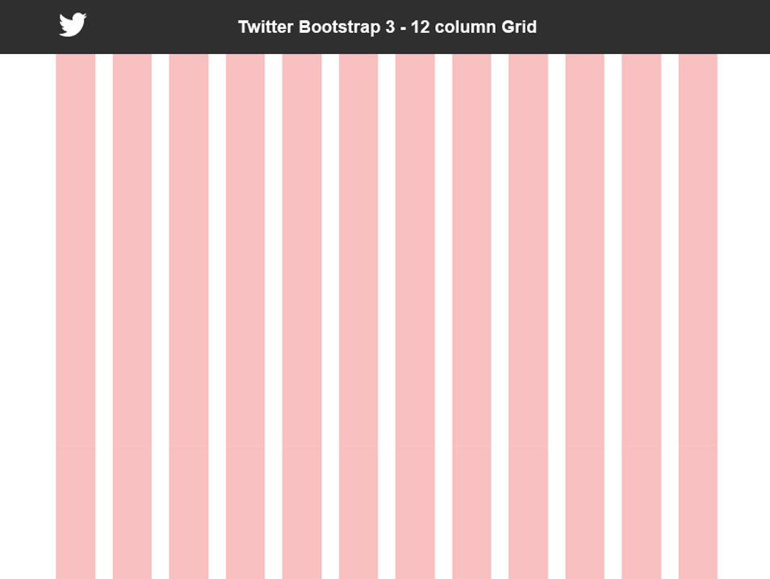
Bootstrap
CSS framework
12 columns

Slide 13
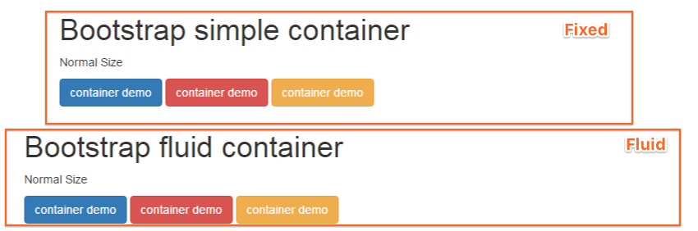
Service Portal and Bootstrap
In Service Portal, bootstrap columns are embedded inside containers.
Containers can be fixed (default), or fluid.

Slide 14
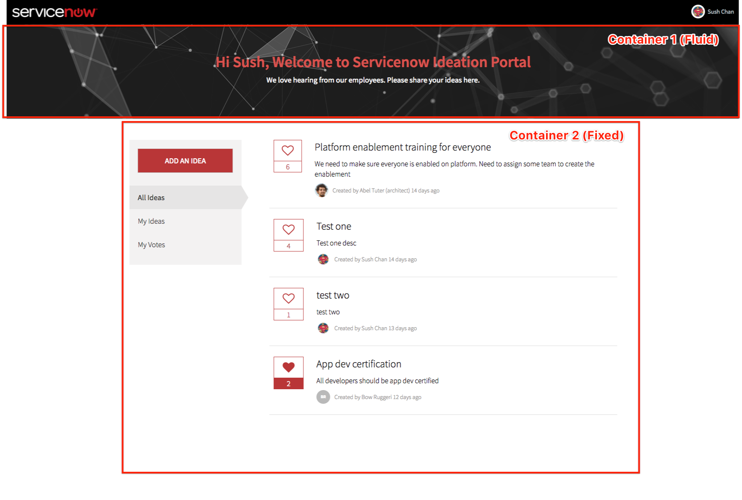
Idea Home Container Layout

Slide 15
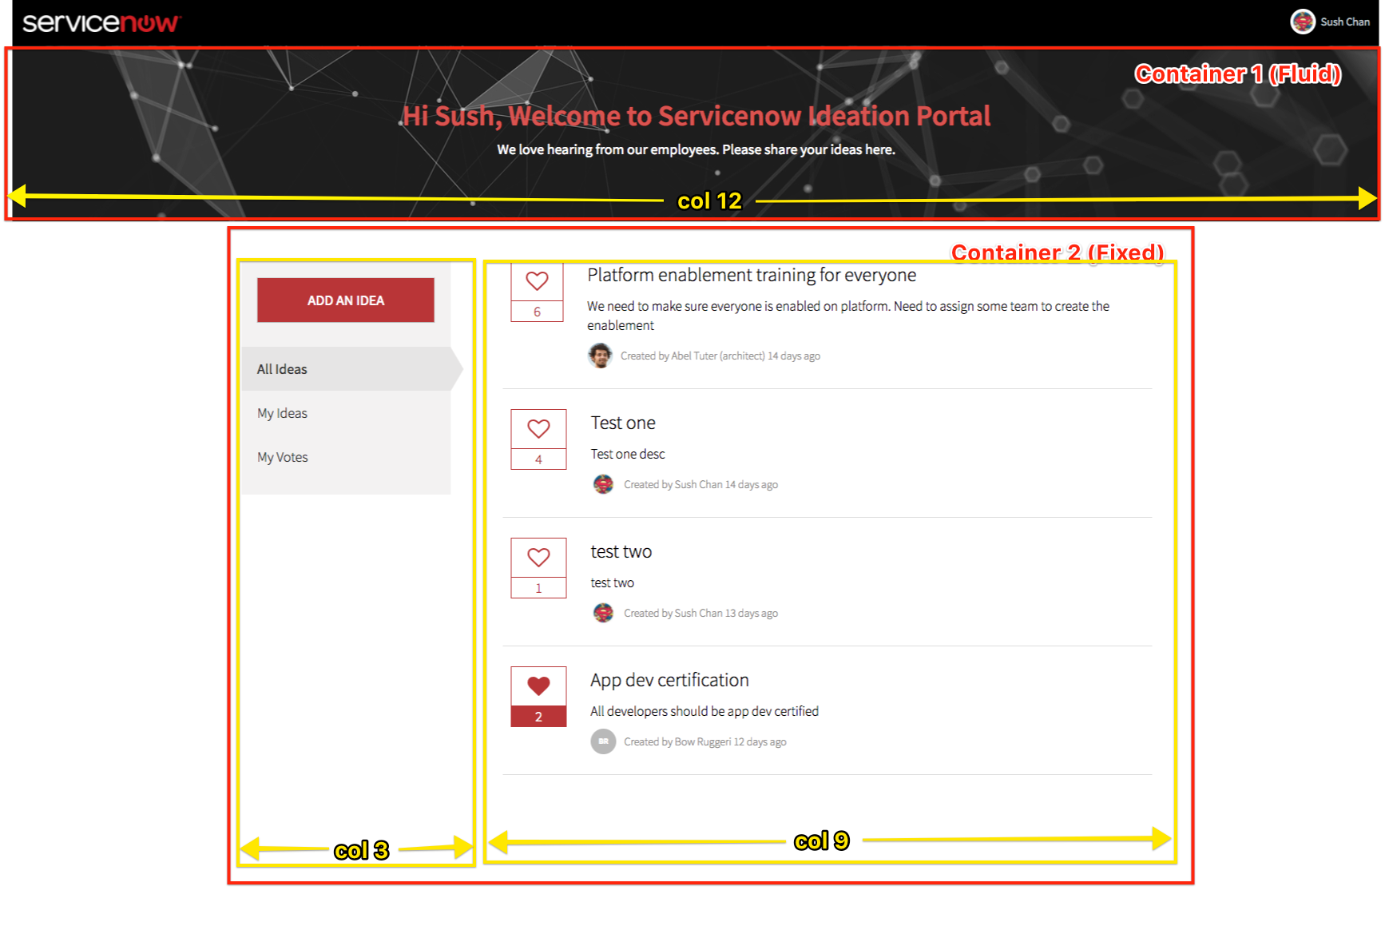
Idea Home Columns

Slide 16
Lab 3 Banner Widget
Notes:
Lab 3: Banner Widget

Slide 17
Lab 4 Sidebar Widget
Notes:
Lab 4: Sidebar Widget
Creating Widgets
Communicating Between Widgets

Slide 18
Using AngularJS $broadcast and $emit
To notify or pass data between widgets we can $broadcast() or $emit()
These events can be caught using $on()
You can initiate $broadcast and $emit on $rootScope or $scope For ex:$scope.$broadcast() or $rootScope.$broadcast() etc
The behavior is different when you fire event using $scope vs $rootScope.

Slide 19
$scope.$emit() and $scope.$broadcast()
These can be used when you have nested widgets.
$scope.$broadcast() sends event downwards, i.e to all the child widgets.
$scope.$emit() sends event upwards, i.e from current widget to all the parent widgets.
The events can be caught in child or parent widgets using $scope.$on()
This setup wont work for our example coz we don’t have any nested widgets on our page. All widgets our page are siblings.

Slide 20
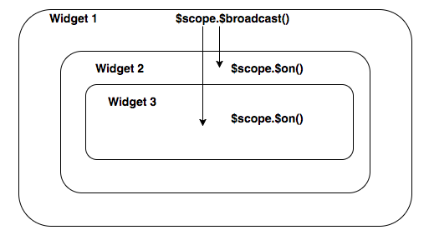
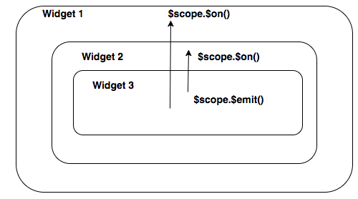
$scope.$broadcast() vs $scope.$emit()

Slide 21
$rootScope.$broadcast()
Should be used when we have sibling widgets (no parent child relationship)
Here event will be broadcasted to all sibling widgets
We will be using this communicate between our widgets. Ex: $rootScope.$broadcast(”EventName", "data");
Event can be caught using $scope.$on() or $rootScope.$on() Ex:
$scope.$on("EventName", function (evt, data) {
//Do something
});

Slide 22
Lab 5 List Widget
Notes:
Lab 5: List Widget
Goal
Create the Widget
The Idea Votes Table
Scripted REST API
Record Watcher
Moment.js
Widget Communication (continued)

Slide 23
$rootScope.$broadcast()
Should be used when we have sibling widgets (no parent child relationship)
Here event will be broadcasted to all sibling widgets
We will be using this communicate between our widgets. Ex: $rootScope.$broadcast(”EventName", "data");
Event can be caught using $scope.$on() or $rootScope.$on() Ex:
$scope.$on("EventName", function (evt, data) {
//Do something
});

Slide 24
Lab 5 List Widget
Notes:
Lab 5: List Widget
Using External Libraries

Slide 25
Lab 6 Submit an Idea Page
Notes:
Lab 6: Submit an Idea Page
Goal
Auto redirect on Idea Submission
Navigating Between Pages using $location

Slide 26
Questions?

